Slide 1
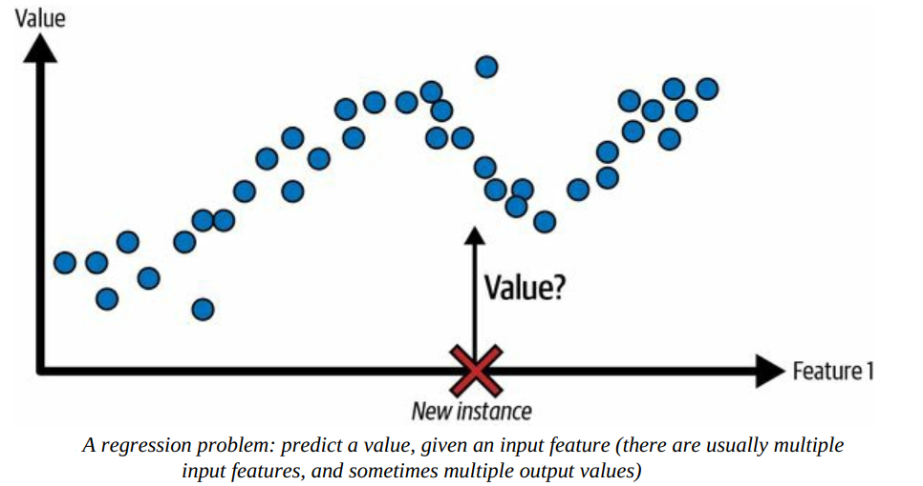
Supervised Learning: Regression
A typical task is to predict a target numeric value, such as the price of a car, given a set of features (mileage, age, brand, etc.). This sort of task is called regression.⁠

Slide 2
Regression
Simple Linear Regression
Multiple Linear Regression
Polynomial Linear Regression
Logistic Regression

Slide 3
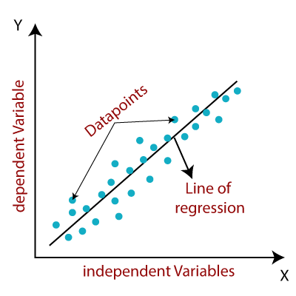
Linear Regression
Linear regression is a supervised machine learning algorithm that models the linear relationship between a dependent variable and one or more independent variables by fitting a straight line to the observed data.
https://www.javatpoint.com/linear-regression-in-machine-learning

Slide 4
Linear Regression
Linear regression is a supervised machine learning algorithm that models the linear relationship between a dependent variable and one or more independent variables by fitting a straight line to the observed data.
When there is a single independent variable, it is referred to as Simple Linear Regression, whereas with multiple independent variables, it is called Multiple Linear Regression.
Polynomial Linear Regression is a form of regression where the relationship between the independent variable(s) and the dependent variable is modeled as a polynomial, but it is still considered a type of linear regression because the model is linear in terms of the coefficients.

Slide 5
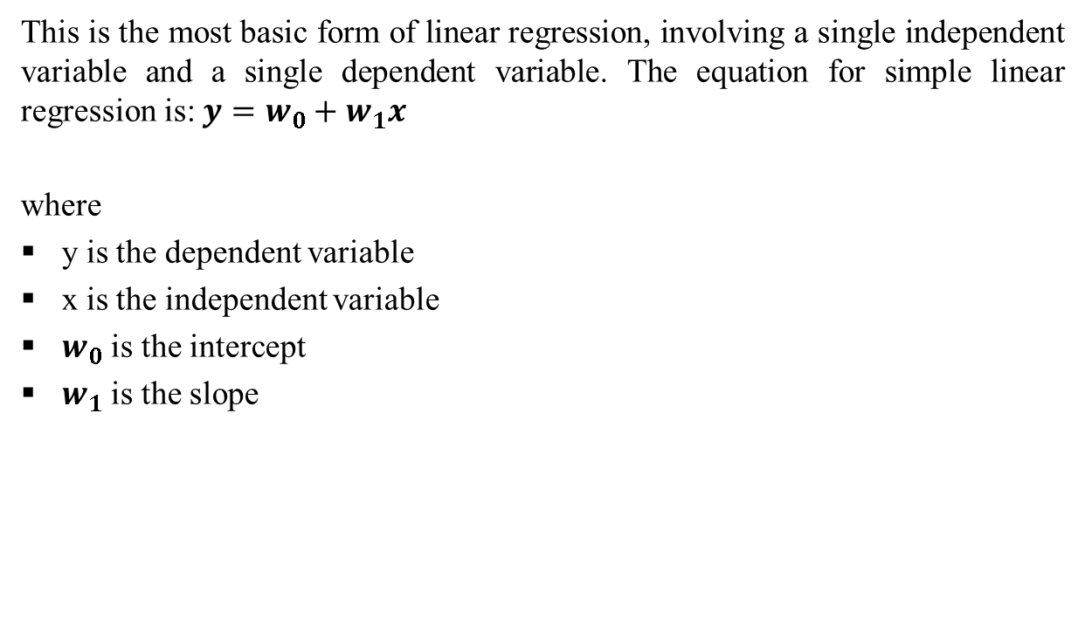
Simple Linear Regression
This is the most basic form of linear regression, involving a single independent variable and a single dependent variable. The equation for simple linear regression is: $y=w_{0}+w_{1}x$
where
y is the dependent variable
x is the independent variable
$w_{0}$ is the intercept
$w_{1}$ is the slope

Slide 6
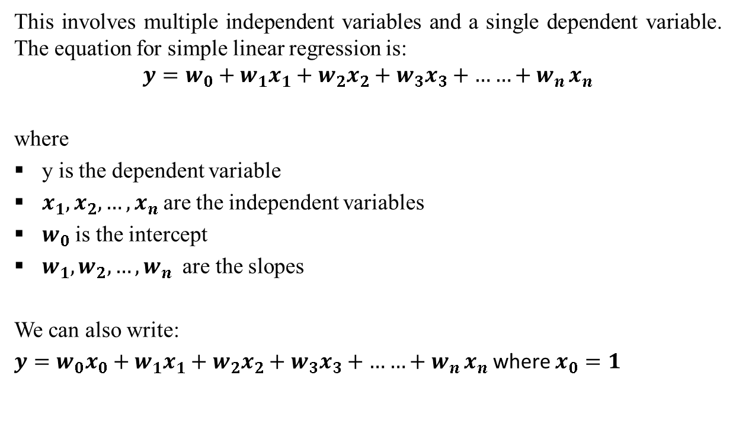
Multiple Linear Regression
This involves multiple independent variables and a single dependent variable. The equation for simple linear regression is:
$$y=w_{0}+w_{1}x_{1}+w_{2}x_{2}+w_{3}x_{3}+{……+w}_{n}x_{n}$$
where
y is the dependent variable
$x_{1},x_{2}, …,x_{n}$are the independent variables
$w_{0}$ is the intercept
$w_{1},w_{2}, …,w_{n}$ are the slopes
We can also write:
$y=w_{0}x_{0}+w_{1}x_{1}+w_{2}x_{2}+w_{3}x_{3}+{……+w}_{n}x_{n}$ where $x_{0}=1$

Slide 7
Linear Regression
The objective of the algorithm is to determine the best-fit line equation that can predict values based on the independent variables.
In regression, a dataset with X and Y values is provided, and these values are used to train a function. Once trained, this function can be applied to predict Y for an unknown X.
In regression, the goal is to estimate the value of Y, meaning a function is needed that predicts the continuous Y value given X as the independent variable(s).

Slide 8
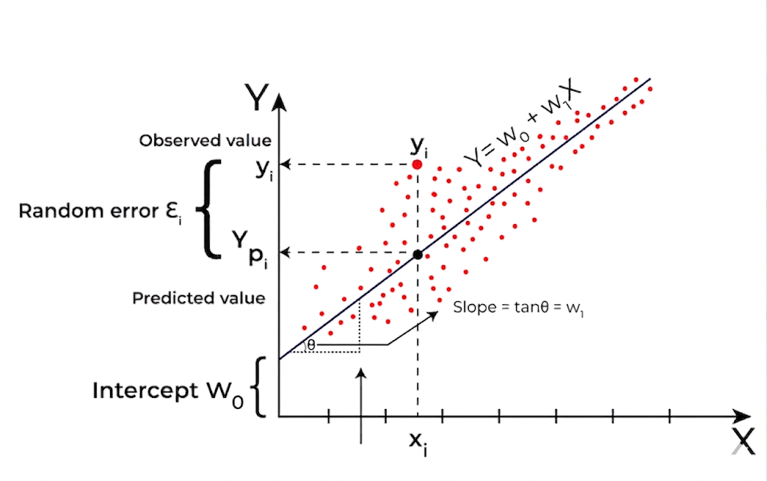
Linear Regression
What is the best Fit Line?
The main goal of using linear regression is to find the best-fit line, which minimizes the error between the predicted and actual values. The best-fit line will have the least amount of error.
The equation of the best-fit line represents the relationship between the dependent and independent variables, with the slope indicating how much the dependent variable changes in response to a unit change in the independent variable(s).

Slide 9
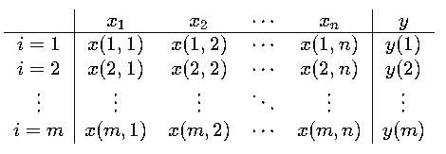
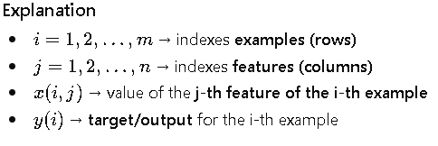
Linear Regression
Consider a dataset

Slide 10
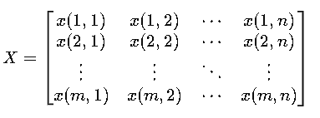
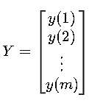
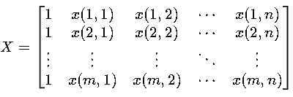
Linear Regression
The dataset inn Matrix Form
Feature Matrix (with bias)

Slide 11

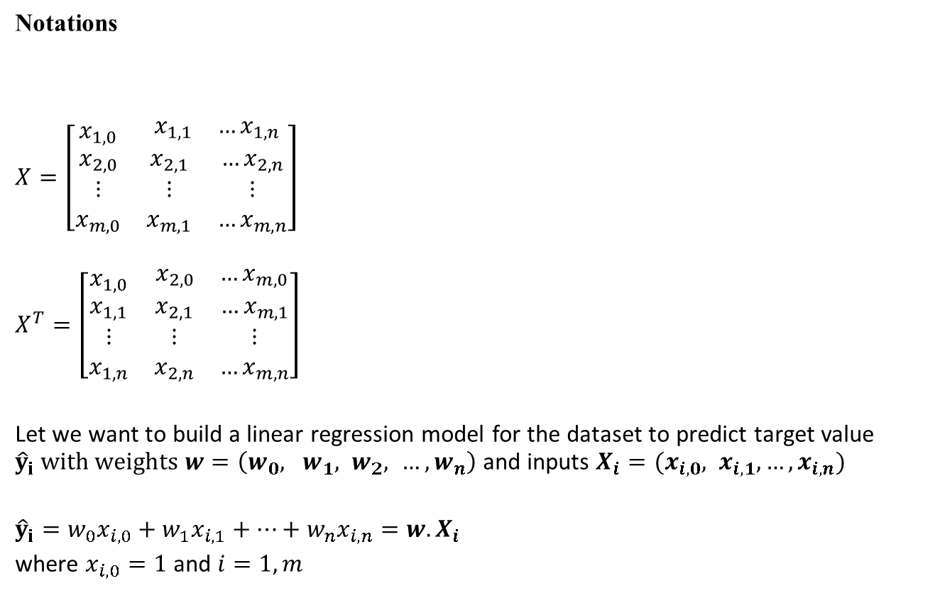
Linear Regression
Notations
$X=\left[\begin{matrix}x_{1,0} & \begin{matrix}x_{1,1} & …x_{1,n}\end{matrix} \\ \begin{matrix}x_{2,0} \\ ⋮ \\ x_{m,0}\end{matrix} & \begin{matrix}x_{2,1} & …x_{2,n} \\ ⋮ & ⋮ \\ x_{m,1} & …x_{m,n}\end{matrix}\end{matrix}\right]$
$$X^{T}=\left[\begin{matrix}x_{1,0} & \begin{matrix}x_{2,0} & …x_{m,0}\end{matrix} \\ \begin{matrix}x_{1,1} \\ ⋮ \\ x_{1,n}\end{matrix} & \begin{matrix}x_{2,1} & …x_{m,1} \\ ⋮ & ⋮ \\ x_{2,n} & …x_{m,n}\end{matrix}\end{matrix}\right]$$
Let we want to build a linear regression model for the dataset to predict target value ${\hat{y}}_{i} with weights w=\left(w_{0}, w_{1}, w_{2}, …, w_{n}\right)$ and inputs $X_{i}=(x_{i,0}, x_{i,1},…, x_{i,n})$
${\hat{y}}_{i}=w_{0}x_{i,0}+w_{1}x_{i,1}+…+w_{n}x_{i,n}={w.X}_{i}$
where $x_{i,0}=1$ and $i=1,m$
Remember
$y=w_{0}x_{0}+w_{1}x_{1}+w_{2}x_{2}+w_{3}x_{3}+{……+w}_{n}x_{n}$ where $x_{0}=1$
For ith row in the dataset, we can write the prediction as,
$${{\hat{y}}_{i}=w}_{0}x_{i,0}+w_{1}x_{i,1}+…+w_{n}x_{i,n}$$

Slide 12
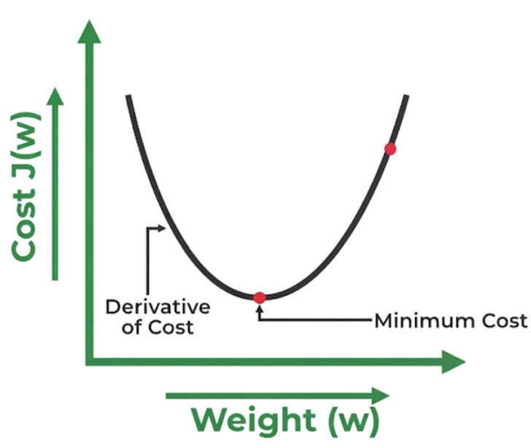
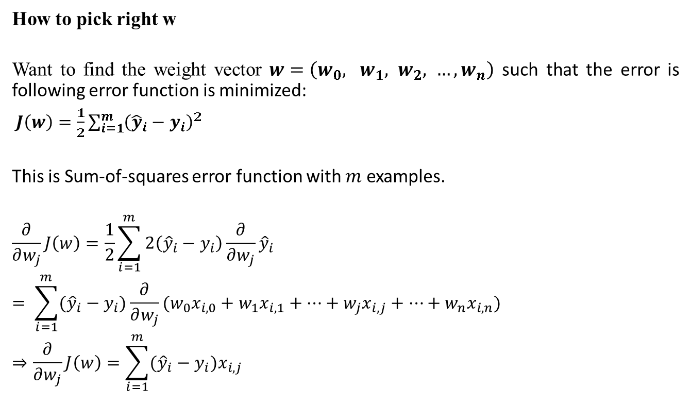
Linear Regression
How to pick right w
Want to find the weight vector $w=\left(w_{0}, w_{1}, w_{2}, …, w_{n}\right)$ such that the error is following error function is minimized:
$J\left(w\right)=\frac{1}{2}\sum_{i=1}^{m}{{\left({\hat{y}}_{i}−y_{i}\right)}^{2}}$
This is Sum-of-squares error function with $m$ examples.
$$\frac{∂}{∂w_{j}}J\left(w\right)=\frac{1}{2}\sum_{i=1}^{m}{2\left({\hat{y}}_{i}−y_{i}\right)\frac{∂}{∂w_{j}}{\hat{y}}_{i} }$$
$$= \sum_{i=1}^{m}{({\hat{y}}_{i}−y_{i})\frac{∂}{∂w_{j}}(w_{0}x_{i,0}+w_{1}x_{i,1}+…+w_{j}x_{i,j}+…+w_{n}x_{i,n})}$$
$$⇒\frac{∂}{∂w_{j}}J\left(w\right)=\sum_{i=1}^{m}{({\hat{y}}_{i}−y_{i})x_{i,j}}$$

Slide 13
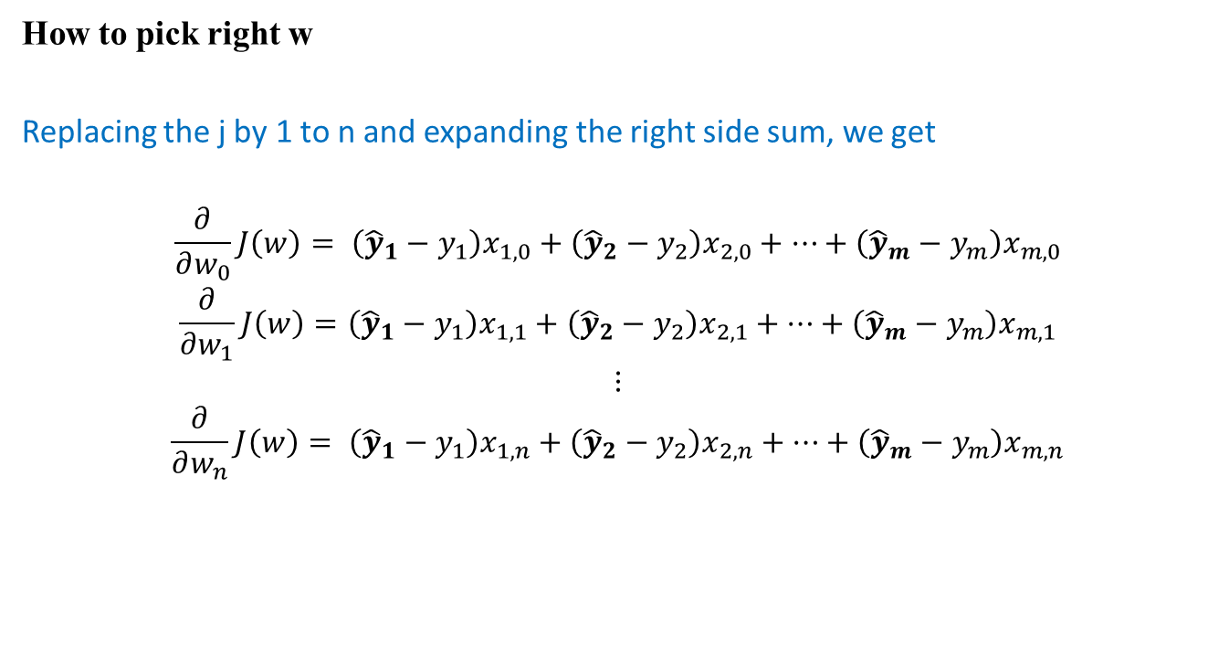
Linear Regression
How to pick right w
Replacing the j by 1 to n and expanding the right side sum, we get
$$\frac{∂}{∂w_{0}}J\left(w\right)= \left({\hat{y}}_{1}−y_{1}\right)x_{1,0}+\left({\hat{y}}_{2}−y_{2}\right)x_{2,0}+…+\left({\hat{y}}_{m}−y_{m}\right)x_{m,0}$$
$$\frac{∂}{∂w_{1}}J\left(w\right)=\left({\hat{y}}_{1}−y_{1}\right)x_{1,1}+\left({\hat{y}}_{2}−y_{2}\right)x_{2,1}+…+\left({\hat{y}}_{m}−y_{m}\right)x_{m,1}$$
$$⋮$$
$$\frac{∂}{∂w_{n}}J\left(w\right)= \left({\hat{y}}_{1}−y_{1}\right)x_{1,n}+\left({\hat{y}}_{2}−y_{2}\right)x_{2,n}+…+\left({\hat{y}}_{m}−y_{m}\right)x_{m,n}$$

Slide 14
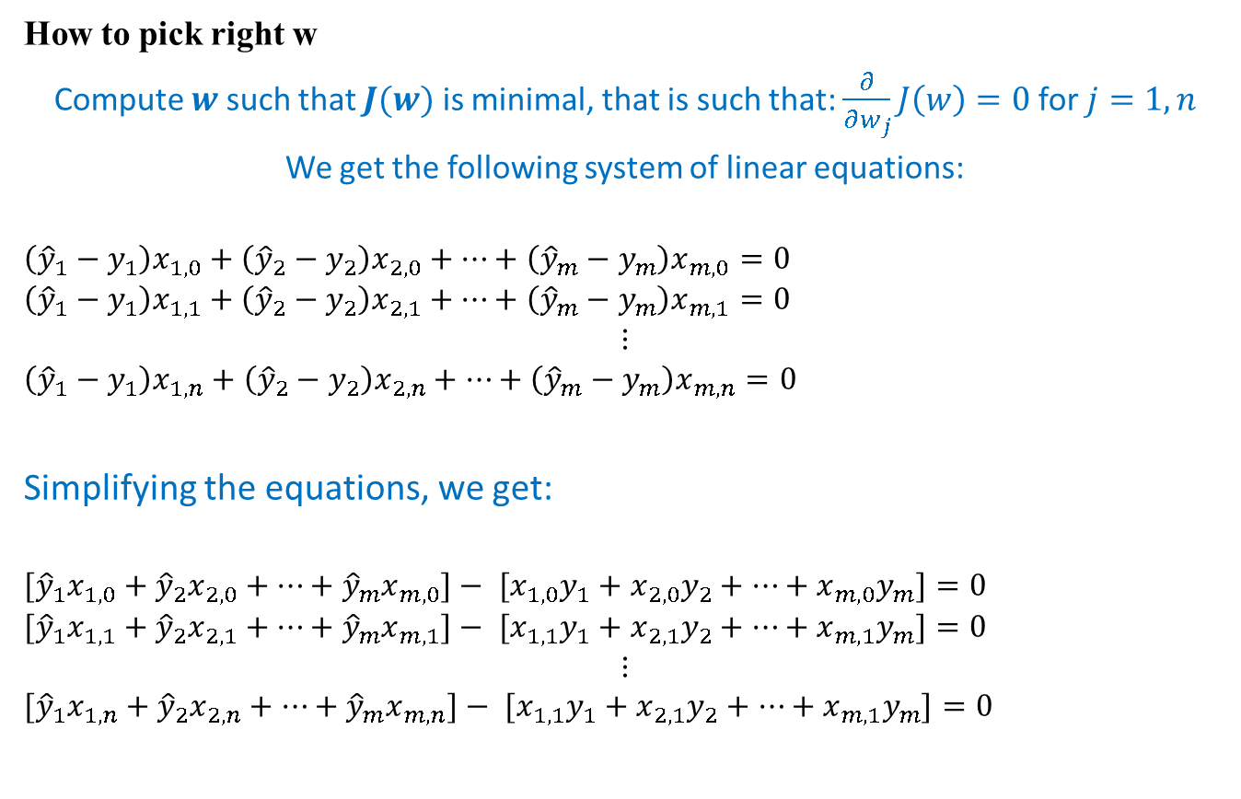
Linear Regression
How to pick right w
Compute $w$ such that $J(w)$ is minimal, that is such that: $\frac{∂}{∂w_{j}}J\left(w\right)=0$ for $j=1,n$
We get the following system of linear equations:
$$\left({\hat{y}}_{1}−y_{1}\right)x_{1,0}+\left({\hat{y}}_{2}−y_{2}\right)x_{2,0}+…+\left({\hat{y}}_{m}−y_{m}\right)x_{m,0}=0$$
$$\left({\hat{y}}_{1}−y_{1}\right)x_{1,1}+\left({\hat{y}}_{2}−y_{2}\right)x_{2,1}+…+\left({\hat{y}}_{m}−y_{m}\right)x_{m,1}=0$$
$$⋮$$
$$\left({\hat{y}}_{1}−y_{1}\right)x_{1,n}+\left({\hat{y}}_{2}−y_{2}\right)x_{2,n}+…+\left({\hat{y}}_{m}−y_{m}\right)x_{m,n}=0$$
Simplifying the equations, we get:
$$[{\hat{y}}_{1}x_{1,0}+{\hat{y}}_{2}x_{2,0}+…+{\hat{y}}_{m}x_{m,0}]− {[x}_{1,0}y_{1}+x_{2,0}y_{2}+…+x_{m,0}y_{m}]=0$$
$${[\hat{y}}_{1}x_{1,1}+{\hat{y}}_{2}x_{2,1}+…+{\hat{y}}_{m}x_{m,1}]− {[x}_{1,1}y_{1}+x_{2,1}y_{2}+…+x_{m,1}y_{m}]=0$$
$$⋮$$
$${[\hat{y}}_{1}x_{1,n}+{\hat{y}}_{2}x_{2,n}+…+{\hat{y}}_{m}x_{m,n}]− {[x}_{1,1}y_{1}+x_{2,1}y_{2}+…+x_{m,1}y_{m}]=0$$

Slide 15

Linear Regression
How to pick right w
After applying, ${\hat{y}}_{i}={w.X}_{i}$
$$[({w.X}_{1})x_{1,0}+({w.X}_{2})x_{2,0}+…+({w.X}_{m})x_{m,0}]− {[x}_{1,0}y_{1}+x_{2,0}y_{2}+…+x_{m,0}y_{m}]=0$$
$$[({w.X}_{1})x_{1,1}+({w.X}_{2})x_{2,1}+…+({w.X}_{m})x_{m,1}]− {[x}_{1,1}y_{1}+x_{2,1}y_{2}+…+x_{m,1}y_{m}]=0$$
$$⋮$$
$$[({w.X}_{1})x_{1,n}+({w.X}_{2})x_{2,n}+…+({w.X}_{m})x_{m,n}]− {[x}_{1,n}y_{1}+x_{2,n}y_{2}+…+x_{m,n}y_{m}]=0$$

Slide 16
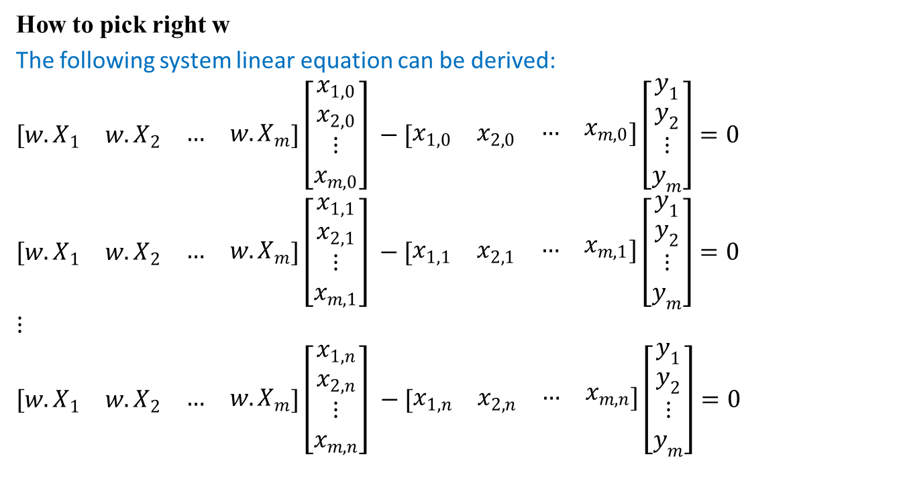
Linear Regression
How to pick right w
The following system linear equation can be derived:
$$[\begin{matrix}{w.X}_{1} & {w.X}_{2} & \begin{matrix}… & {w.X}_{m}\end{matrix}]\left[\begin{matrix}x_{1,0} \\ x_{2,0} \\ \begin{matrix}⋮ \\ x_{m,0}\end{matrix}\end{matrix}\right] \end{matrix}−[\begin{matrix}x_{1,0} & x_{2,0} & \begin{matrix}… & x_{m,0}\end{matrix}]\end{matrix}\left[\begin{matrix}y_{1} \\ y_{2} \\ \begin{matrix}⋮ \\ y_{m}\end{matrix}\end{matrix}\right]=0$$
$$[\begin{matrix}{w.X}_{1} & {w.X}_{2} & \begin{matrix}… & {w.X}_{m}\end{matrix}]\left[\begin{matrix}x_{1,1} \\ x_{2,1} \\ \begin{matrix}⋮ \\ x_{m,1}\end{matrix}\end{matrix}\right] \end{matrix}−[\begin{matrix}x_{1,1} & x_{2,1} & \begin{matrix}… & x_{m,1}\end{matrix}]\end{matrix}\left[\begin{matrix}y_{1} \\ y_{2} \\ \begin{matrix}⋮ \\ y_{m}\end{matrix}\end{matrix}\right]=0$$
$$⋮$$
$$[\begin{matrix}{w.X}_{1} & {w.X}_{2} & \begin{matrix}… & {w.X}_{m}\end{matrix}]\left[\begin{matrix}x_{1,n} \\ x_{2,n} \\ \begin{matrix}⋮ \\ x_{m,n}\end{matrix}\end{matrix}\right] \end{matrix}−[\begin{matrix}x_{1,n} & x_{2,n} & \begin{matrix}… & x_{m,n}\end{matrix}]\end{matrix}\left[\begin{matrix}y_{1} \\ y_{2} \\ \begin{matrix}⋮ \\ y_{m}\end{matrix}\end{matrix}\right]=0$$

Slide 17
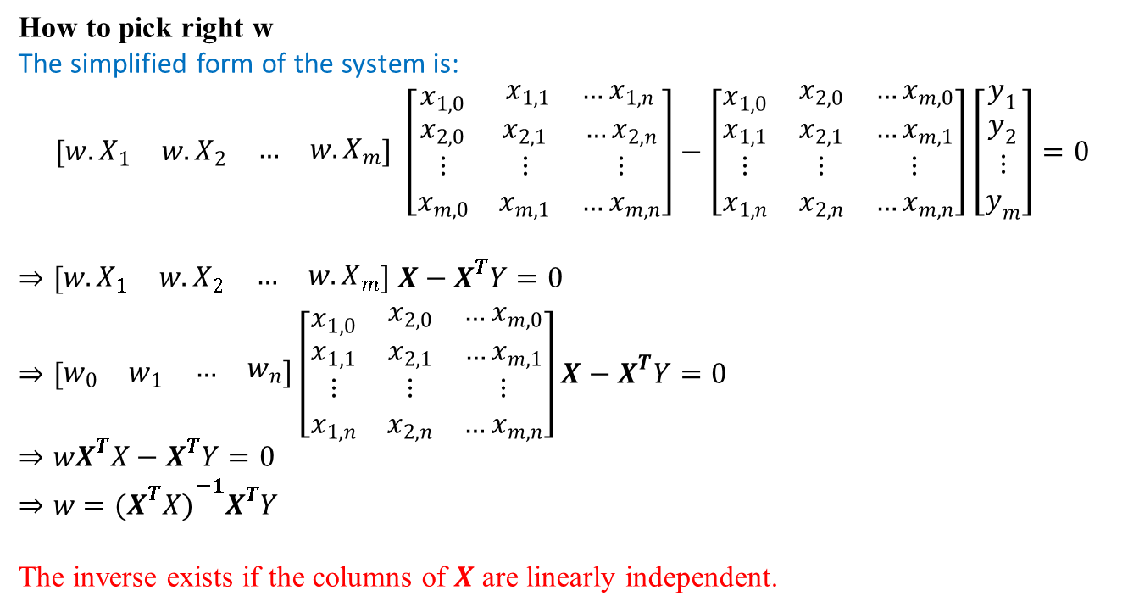
Linear Regression
How to pick right w
The simplified form of the system is:
$$[\begin{matrix}{w.X}_{1} & {w.X}_{2} & \begin{matrix}… & {w.X}_{m}\end{matrix}] \end{matrix}\left[\begin{matrix}x_{1,0} & \begin{matrix}x_{1,1} & …x_{1,n}\end{matrix} \\ \begin{matrix}x_{2,0} \\ ⋮ \\ x_{m,0}\end{matrix} & \begin{matrix}x_{2,1} & …x_{2,n} \\ ⋮ & ⋮ \\ x_{m,1} & …x_{m,n}\end{matrix}\end{matrix}\right]−\left[\begin{matrix}x_{1,0} & \begin{matrix}x_{2,0} & …x_{m,0}\end{matrix} \\ \begin{matrix}x_{1,1} \\ ⋮ \\ x_{1,n}\end{matrix} & \begin{matrix}x_{2,1} & …x_{m,1} \\ ⋮ & ⋮ \\ x_{2,n} & …x_{m,n}\end{matrix}\end{matrix}\right]\left[\begin{matrix}y_{1} \\ y_{2} \\ \begin{matrix}⋮ \\ y_{m}\end{matrix}\end{matrix}\right]=0$$
$$⇒[\begin{matrix}{w.X}_{1} & {w.X}_{2} & \begin{matrix}… & {w.X}_{m}\end{matrix}] \end{matrix}X−X^{T}Y=0$$
$⇒[\begin{matrix}w_{0} & w_{1} & \begin{matrix}… & w_{n}\end{matrix}]\end{matrix}\left[\begin{matrix}x_{1,0} & \begin{matrix}x_{2,0} & …x_{m,0}\end{matrix} \\ \begin{matrix}x_{1,1} \\ ⋮ \\ x_{1,n}\end{matrix} & \begin{matrix}x_{2,1} & …x_{m,1} \\ ⋮ & ⋮ \\ x_{2,n} & …x_{m,n}\end{matrix}\end{matrix}\right]X−X^{T}Y=0$
$$⇒wX^{T}X−X^{T}Y=0$$
$$⇒w={{(X}^{T}X)}^{−1}X^{T}Y$$
The inverse exists if the columns of 𝑿 are linearly independent.

Slide 18
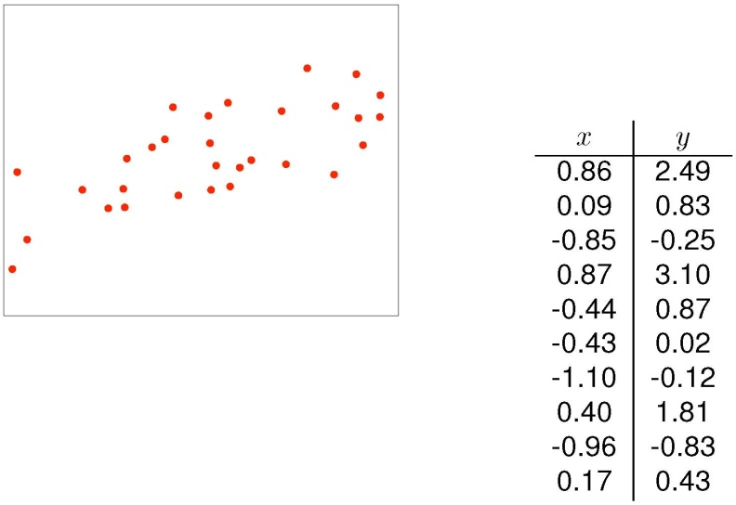
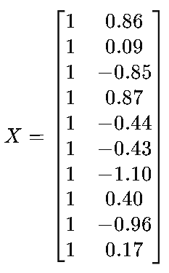
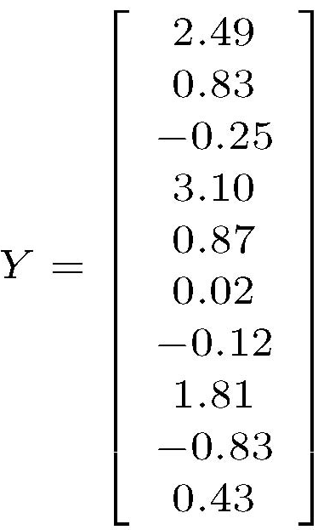

Linear Regression
An example: $w={{(X}^{T}X)}^{−1}X^{T}Y$

Slide 19
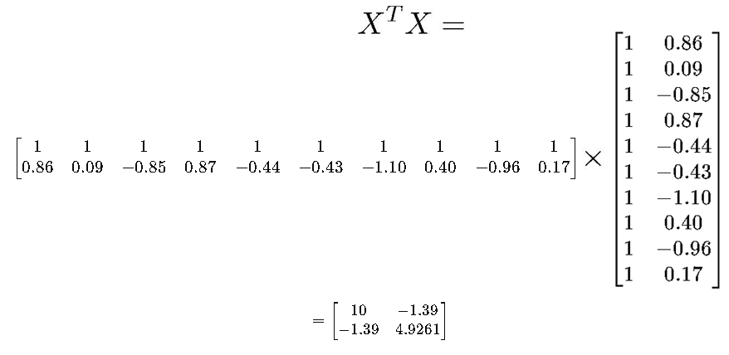
Linear Regression
An example

Slide 20
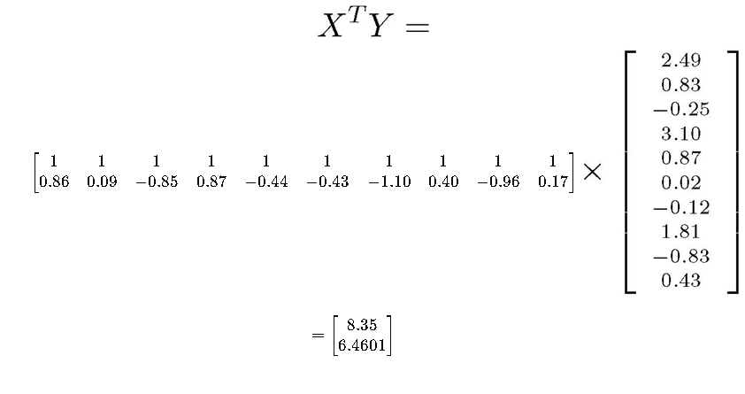
Linear Regression
An example

Slide 21

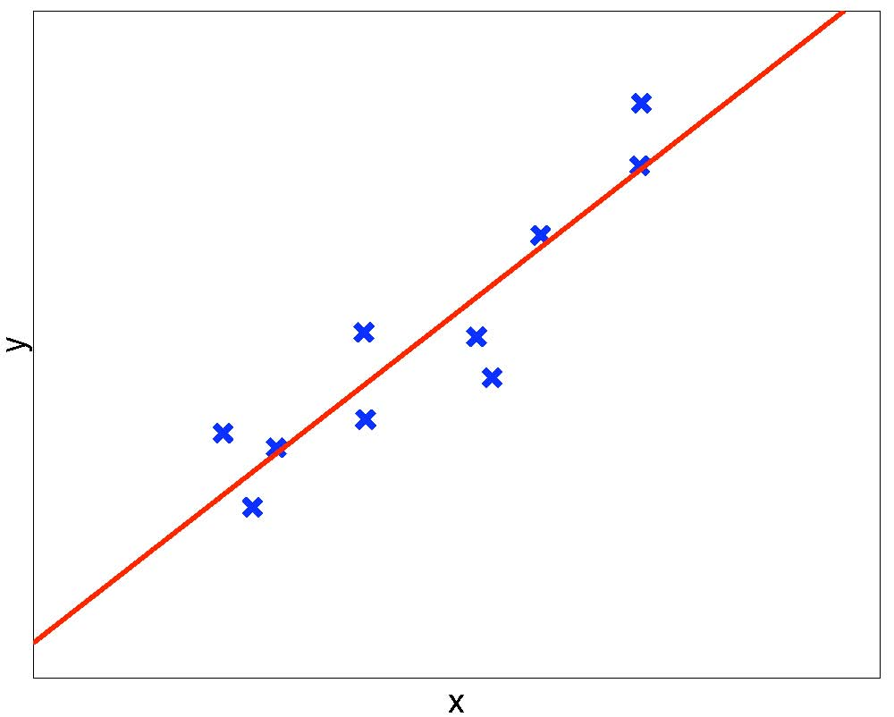

Linear Regression
An example
The fitted linear model is: $y≈1.06+1.61x$

Slide 22

Linear Regression
Summary of the matrix equation
The optimal solution can be computed in polynomial time in the size of the data set.
Too simple for most real-valued problems
The solution is $w={{(X}^{T}X)}^{−1}X^{T}Y$, where
  $X$ is the data matrix, augmented with a column of 1’s $Y$ is the column vector of target outputs
  A very rare case in which an analytical exact solution is possible
    Nice math, closed-form formula, unique global optimum

Slide 23
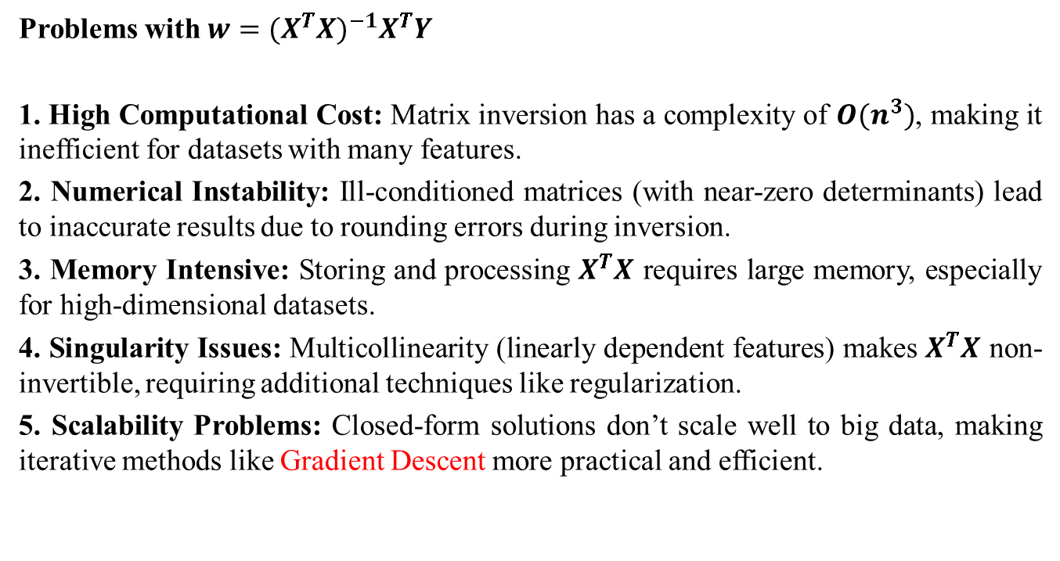
Linear Regression
Problems with $w={{(X}^{T}X)}^{−1}X^{T}Y$
1. High Computational Cost: Matrix inversion has a complexity of $O(n^{3})$, making it inefficient for datasets with many features.
2. Numerical Instability: Ill-conditioned matrices (with near-zero determinants) lead to inaccurate results due to rounding errors during inversion.
3. Memory Intensive: Storing and processing $X^{T}X$ requires large memory, especially for high-dimensional datasets.
4. Singularity Issues: Multicollinearity (linearly dependent features) makes $X^{T}X$ non-invertible, requiring additional techniques like regularization.
5. Scalability Problems: Closed-form solutions don’t scale well to big data, making iterative methods like Gradient Descent more practical and efficient.

Slide 24
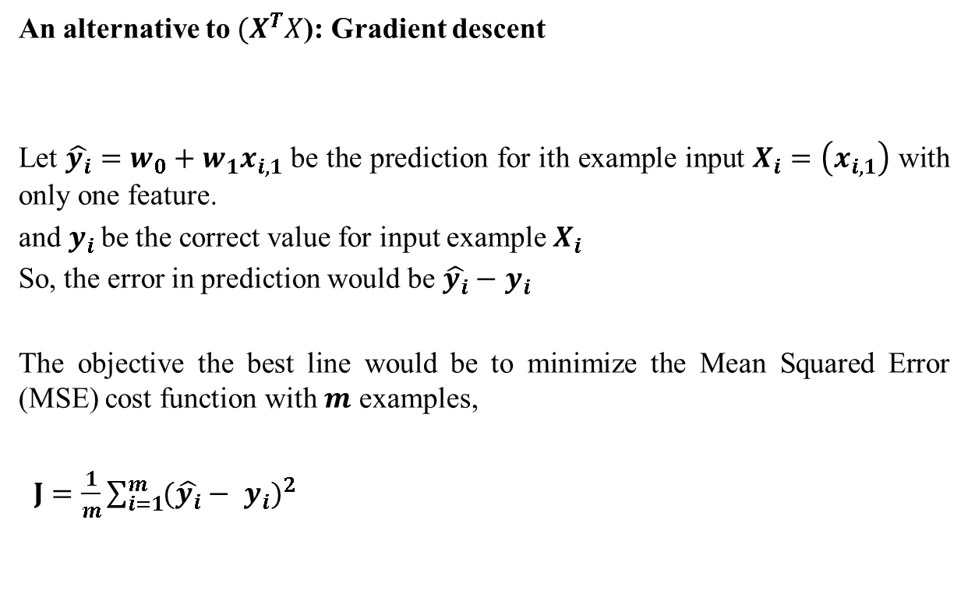
Linear Regression
An alternative to ${(X}^{T}X$): Gradient descent
Let $\hat{y_{i}}=w_{0}+w_{1}x_{i,1}$ be the prediction for ith example input $X_{i}=\left(x_{i,1}\right)$ with only one feature.
and $y_{i}$be the correct value for input example $X_{i}$
So, the error in prediction would be $\hat{y_{i}}−$ $y_{i}$
The objective the best line would be to minimize the Mean Squared Error (MSE) cost function with $m$ examples,
$J=\frac{1}{m}\sum_{i=1}^{m}{{(\hat{y_{i}}− y_{i})}^{2}}$

Slide 25
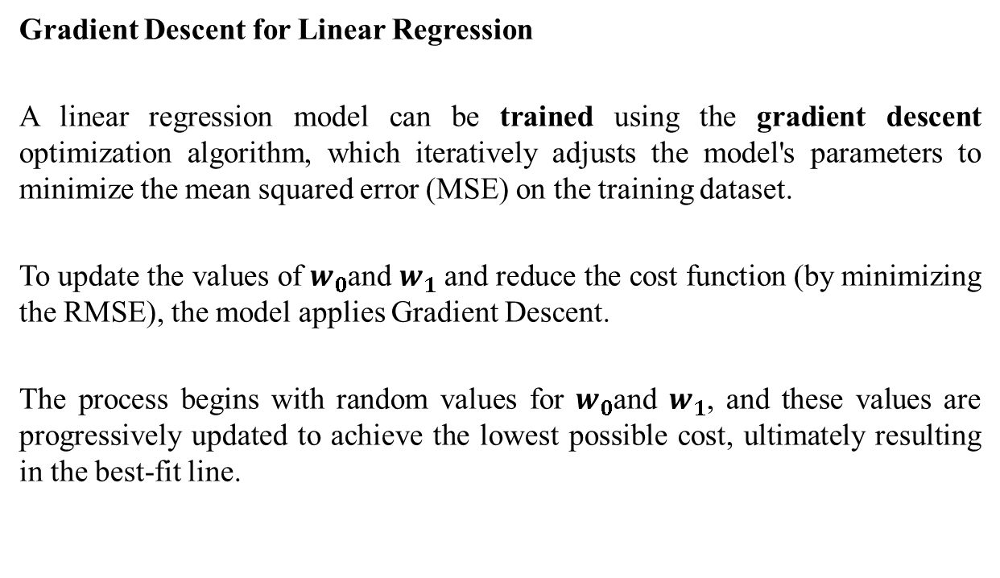
Linear Regression
Gradient Descent for Linear Regression
A linear regression model can be trained using the gradient descent optimization algorithm, which iteratively adjusts the model's parameters to minimize the mean squared error (MSE) on the training dataset.
To update the values of $w_{0}$and $w_{1}$and reduce the cost function (by minimizing the RMSE), the model applies Gradient Descent.
The process begins with random values for $w_{0}$and $w_{1}$, and these values are progressively updated to achieve the lowest possible cost, ultimately resulting in the best-fit line.

Slide 26
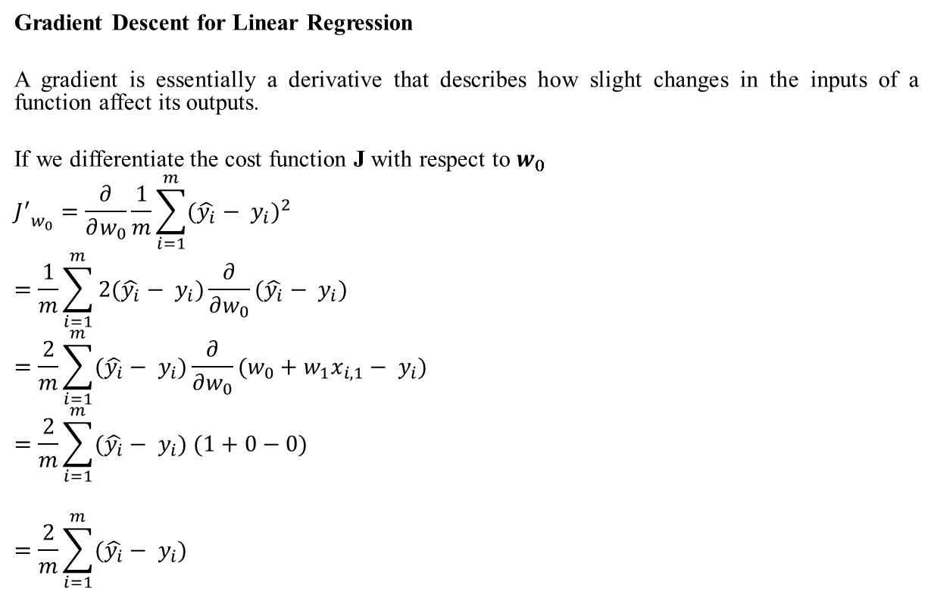
Linear Regression
Gradient Descent for Linear Regression
A gradient is essentially a derivative that describes how slight changes in the inputs of a function affect its outputs.
If we differentiate the cost function J with respect to ​$w_{0}$
$${J^{′}}_{w_{0}}=\frac{∂}{∂w_{0}}\frac{1}{m}\sum_{i=1}^{m}{{(\hat{y_{i}}− y_{i})}^{2}}$$
$$=\frac{1}{m}\sum_{i=1}^{m}{2(\hat{y_{i}}− y_{i})}\frac{∂}{∂w_{0}}(\hat{y_{i}}− y_{i})$$
$$=\frac{2}{m}\sum_{i=1}^{m}{(\hat{y_{i}}− y_{i})}\frac{∂}{∂w_{0}}(w_{0}+w_{1}x_{i,1}− y_{i})$$
$$=\frac{2}{m}\sum_{i=1}^{m}{(\hat{y_{i}}− y_{i}) (1+0−0})$$
$$=\frac{2}{m}\sum_{i=1}^{m}{(\hat{y_{i}}− y_{i})}$$

Slide 27
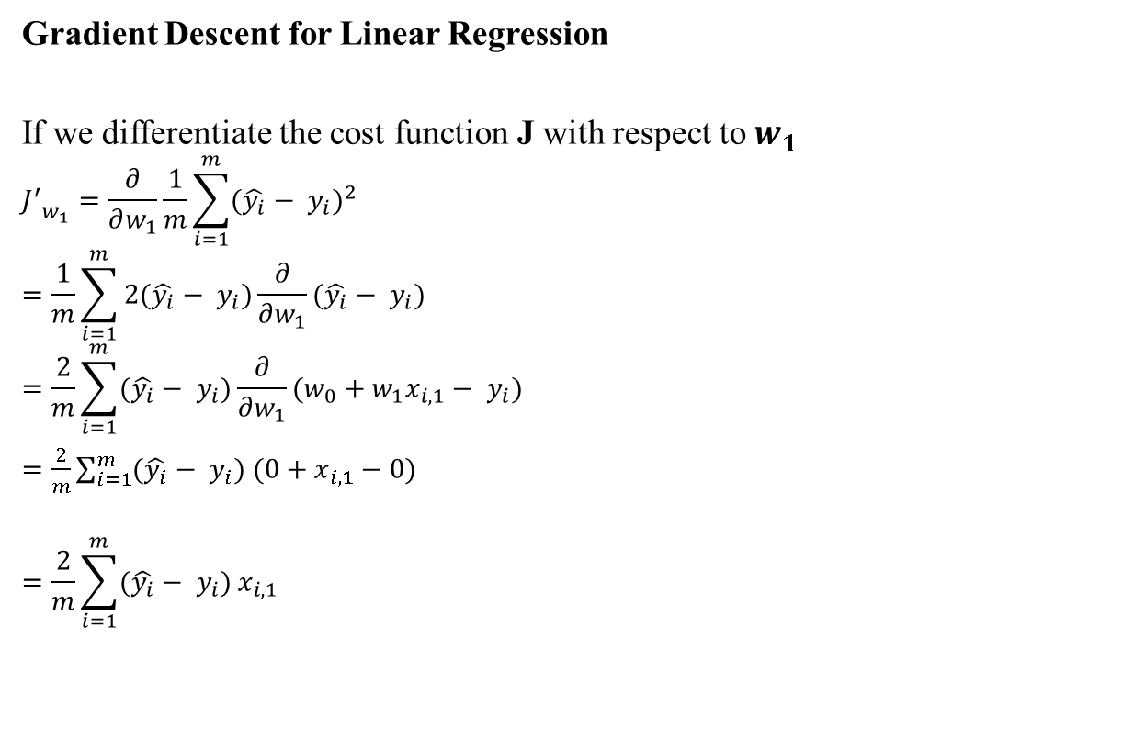
Linear Regression
Gradient Descent for Linear Regression
If we differentiate the cost function J with respect to ​$w_{1}$
$${J^{′}}_{w_{1}}=\frac{∂}{∂w_{1}}\frac{1}{m}\sum_{i=1}^{m}{{(\hat{y_{i}}− y_{i})}^{2}}$$
$$=\frac{1}{m}\sum_{i=1}^{m}{2(\hat{y_{i}}− y_{i})}\frac{∂}{∂w_{1}}(\hat{y_{i}}− y_{i})$$
$$=\frac{2}{m}\sum_{i=1}^{m}{(\hat{y_{i}}− y_{i})}\frac{∂}{∂w_{1}}(w_{0}+w_{1}x_{i,1}− y_{i})$$
$=\frac{2}{m}\sum_{i=1}^{m}{(\hat{y_{i}}− y_{i}) (0+x_{i,1}−0})$
$$=\frac{2}{m}\sum_{i=1}^{m}{(\hat{y_{i}}− y_{i})}x_{i,1}$$

Slide 28
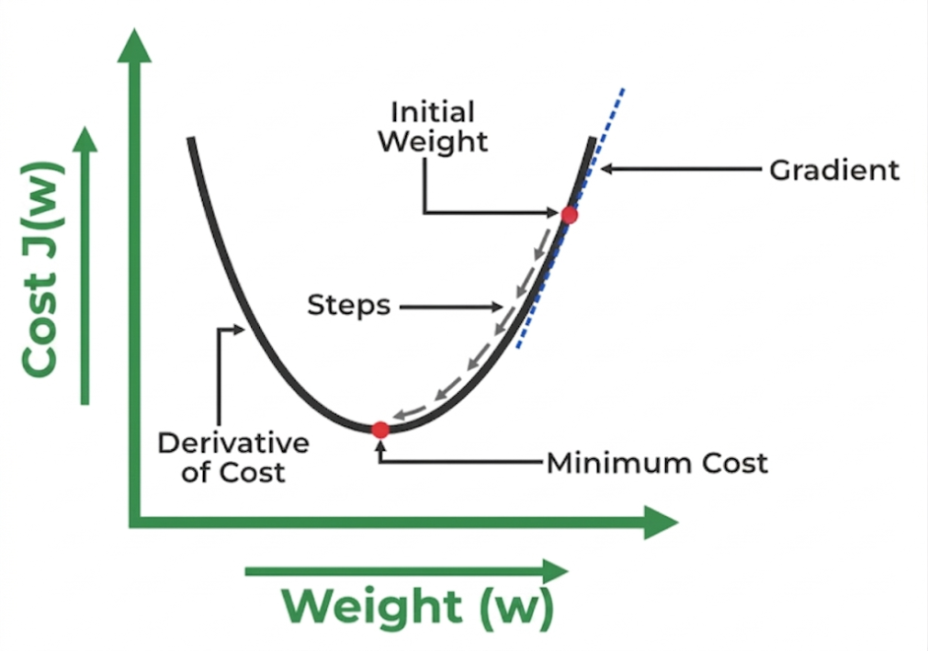
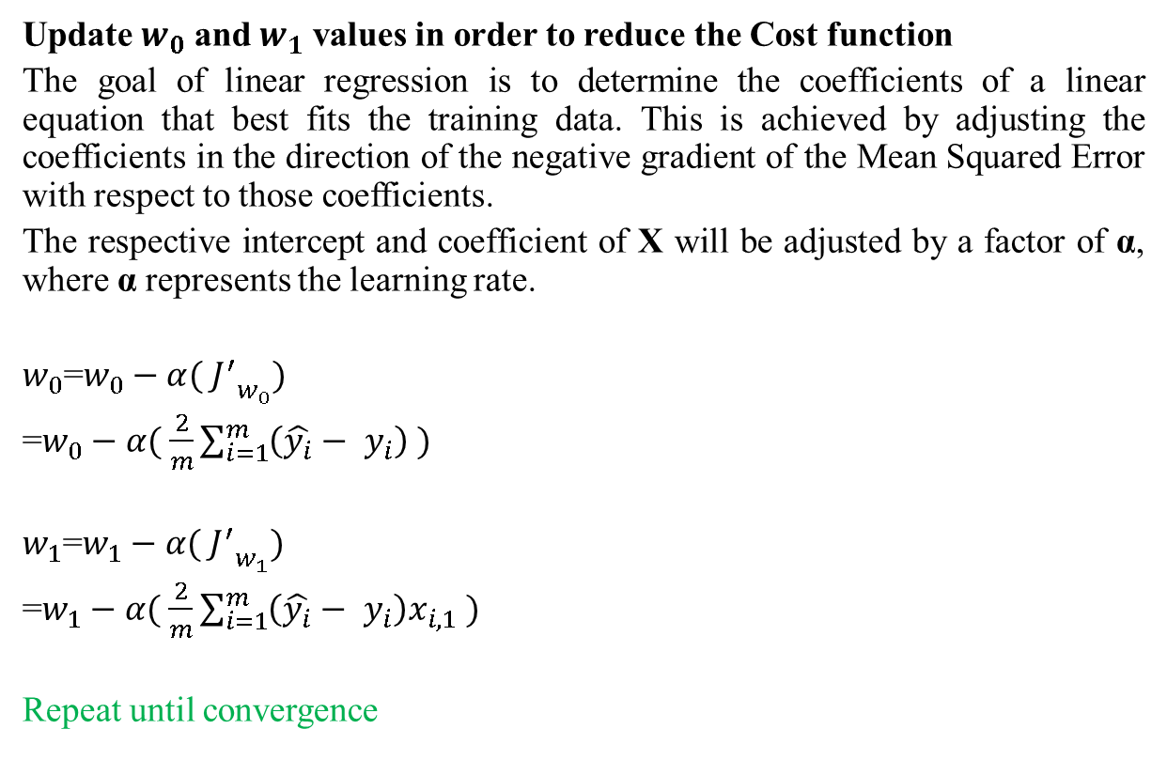
Linear Regression
Update $w_{0}$ and $w_{1}$ values in order to reduce the Cost function
The goal of linear regression is to determine the coefficients of a linear equation that best fits the training data. This is achieved by adjusting the coefficients in the direction of the negative gradient of the Mean Squared Error with respect to those coefficients.
The respective intercept and coefficient of X will be adjusted by a factor of α, where α represents the learning rate.
$w_{0}$=$w_{0}−α( {J^{′}}_{w_{0}})$
=$w_{0}−α( \frac{2}{m}\sum_{i=1}^{m}{\left(\hat{y_{i}}− y_{i}\right)} )$
$w_{1}$=$w_{1}−α( {J^{′}}_{w_{1}})$
=$w_{1}−α( \frac{2}{m}\sum_{i=1}^{m}{\left(\hat{y_{i}}− y_{i}\right)x_{i,1}} )$
Repeat until convergence
https://www.geeksforgeeks.org/ml-linear-regression/

Slide 29

Linear Regression
Numerical Example
$$\hat{y_{i}}=w_{0}+w_{1}x_{i,1}$$
Let $w_{0}$=300,${ w}_{1}$=10
Learning rate, $α=0.0001$
$$\hat{y_{i}}=300+10x_{i,1}$$
$$J=\frac{1}{m}\sum_{i=1}^{m}{{(\hat{y_{i}}− y_{i})}^{2}}$$
Age (x) | Salary (y)
30 | 800
37 | 950
25 | 600
43 | 1050
50 | 1200
29 | 740
46 | 1100

Slide 30
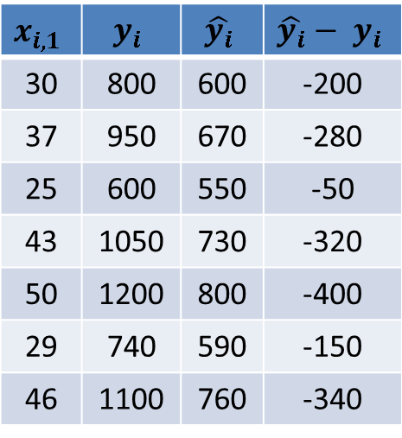

Linear Regression
Numerical Example
$$\hat{y_{i}}=w_{0}+w_{1}x_{i,1}$$
Let $w_{0}$=300,${ w}_{1}$=10
Learning rate, $α=0.0001$
$$\hat{y_{i}}=300+10x_{i,1}$$
$$J=\frac{1}{m}\sum_{i=1}^{m}{{(\hat{y_{i}}− y_{i})}^{2}}$$
$=\frac{1}{7}[{(−200)}^{2}$+${(−280)}^{2}+…]$
$$=74485.71$$
$$x_{i,1}$$ | $$y_{i}$$ | $$\hat{y_{i}}$$ | $$\hat{y_{i}}− y_{i}$$
30 | 800 | 600 | -200
37 | 950 | 670 | -280
25 | 600 | 550 | -50
43 | 1050 | 730 | -320
50 | 1200 | 800 | -400
29 | 740 | 590 | -150
46 | 1100 | 760 | -340

Slide 31
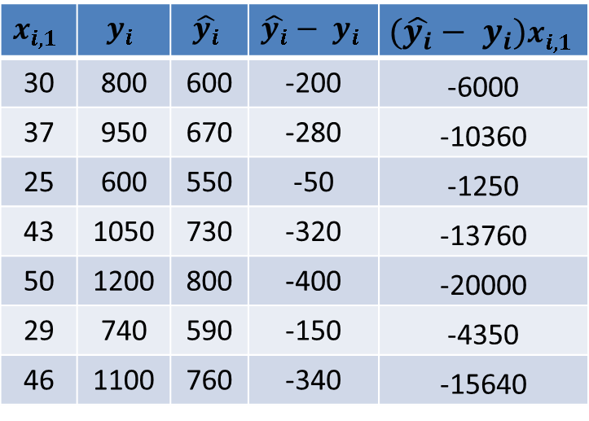

Linear Regression
Numerical Example: Learning (updating $w_{0}$ and $w_{1}$)
$${J^{′}}_{w_{0}}=\frac{2}{m}\sum_{i=1}^{m}{(\hat{y_{i}}− y_{i})}$$
$$=\frac{2}{7}(−200−280−50…)$$
$$=−497.14$$
$${J^{′}}_{w_{1}}=\frac{2}{m}\sum_{i=1}^{m}{(\hat{y_{i}}− y_{i})}x_{i,1}$$
$$=\frac{2}{7}(−6000−10360…)$$
$$=−20388.57$$
$$x_{i,1}$$ | $$y_{i}$$ | $$\hat{y_{i}}$$ | $$\hat{y_{i}}− y_{i}$$ | $$(\hat{y_{i}}− y_{i})x_{i,1}$$
30 | 800 | 600 | -200 | -6000
37 | 950 | 670 | -280 | -10360
25 | 600 | 550 | -50 | -1250
43 | 1050 | 730 | -320 | -13760
50 | 1200 | 800 | -400 | -20000
29 | 740 | 590 | -150 | -4350
46 | 1100 | 760 | -340 | -15640

Slide 32
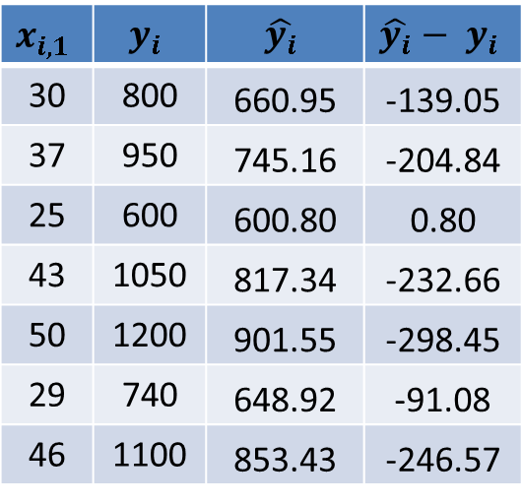

Linear Regression
Numerical Example: Learning (updating $w_{0}$ and $w_{1}$)
$w_{0}$(new)=$w_{0}−α( {J^{′}}_{w_{0}})$
$=300−0.0001∗$($−497.14$)
$$=300.0497$$
$w_{1}$(new)=$w_{1}−α( {J^{′}}_{w_{1}})$
$=10−0.0001∗$($−20388.57$)
$$=12.03$$
Updated equation be
$$\hat{y_{i}}=300.0497+12.03x_{i,1}$$
$$J(new)=\frac{1}{m}\sum_{i=1}^{n}{{\left(\hat{y_{i}}− y_{i}\right)}^{2}}=39084.83$$
$$x_{i,1}$$ | $$y_{i}$$ | $$\hat{y_{i}}$$ | $$\hat{y_{i}}− y_{i}$$
30 | 800 | 660.95 | -139.05
37 | 950 | 745.16 | -204.84
25 | 600 | 600.80 | 0.80
43 | 1050 | 817.34 | -232.66
50 | 1200 | 901.55 | -298.45
29 | 740 | 648.92 | -91.08
46 | 1100 | 853.43 | -246.57
Repeat until convergence

Slide 33
Linear Regression
Example with code
Python Notebook
https://colab.research.google.com/drive/1XIYk601MWojTZaCprZAbFKShll3alG_e

Slide 34
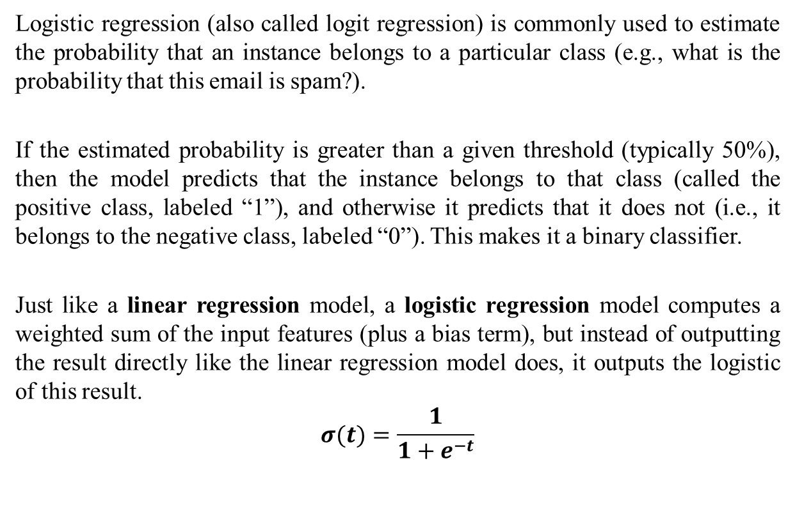
Logistic Regression
Logistic regression (also called logit regression) is commonly used to estimate the probability that an instance belongs to a particular class (e.g., what is the probability that this email is spam?).
If the estimated probability is greater than a given threshold (typically 50%), then the model predicts that the instance belongs to that class (called the positive class, labeled “1”), and otherwise it predicts that it does not (i.e., it belongs to the negative class, labeled “0”). This makes it a binary classifier.
Just like a linear regression model, a logistic regression model computes a weighted sum of the input features (plus a bias term), but instead of outputting the result directly like the linear regression model does, it outputs the logistic of this result.
$$σ(t)=\frac{1}{1+e^{−t}}$$

Slide 35
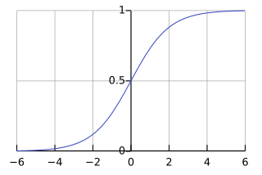
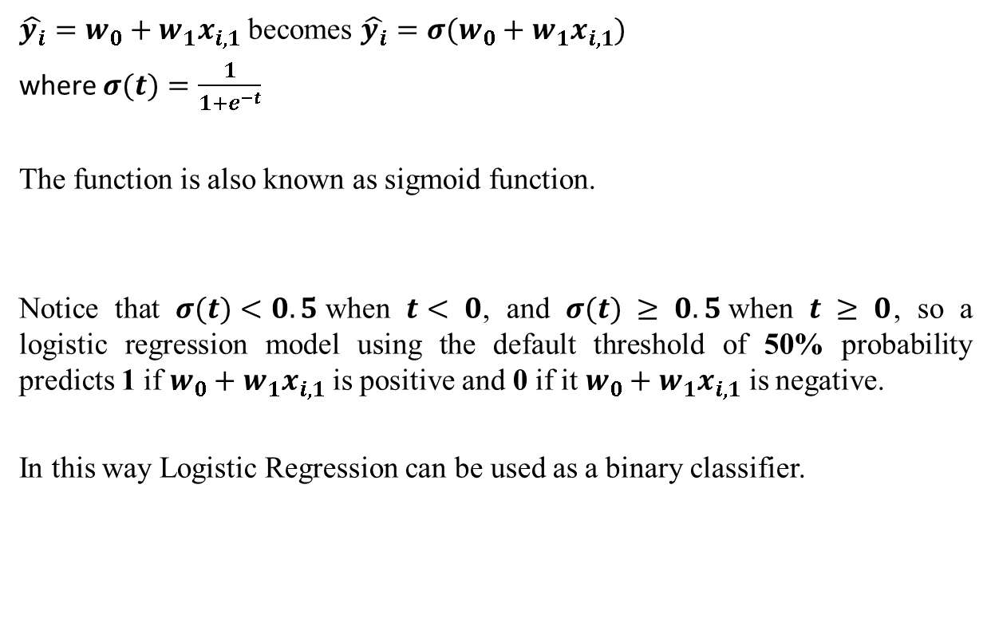
Logistic Regression
$\hat{y_{i}}=w_{0}+w_{1}x_{i,1}$ becomes $\hat{y_{i}}=σ(w_{0}+w_{1}x_{i,1})$
where $σ(t)=\frac{1}{1+e^{−t}}$
The function is also known as sigmoid function.
Notice that $σ(t)<0.5$when $t< 0$, and $σ(t) ≥ 0.5$when $t ≥ 0$, so a logistic regression model using the default threshold of 50% probability predicts 1 if $w_{0}+w_{1}x_{i,1}$ is positive and 0 if it $w_{0}+w_{1}x_{i,1}$ is negative.
In this way Logistic Regression can be used as a binary classifier.
https://en.wikipedia.org/wiki/Sigmoid_function

